Slide 1
Science Jeopardy
Chemistry
Botany
Geology
Meteorology
Electricity
Q $100
Q $100
Q $100
Q $100
Q $100
Q $200
Q $200
Q $200
Q $200
Q $200
Q $300
Q $300
Q $300
Q $300
Q $300
Q $400
Q $400
Q $400
Q $400
Q $400
Q $500
Q $500
Q $500
Q $500
Q $500
Final Jeopardy

Slide 2

$100 Question from Chemistry
What is the symbol for oxygen?

Slide 3
$100 Answer from Chemistry
O

Slide 4
$200 Question from Chemistry
What element does the symbol Na
represent?

Slide 5
$200 Answer from Chemistry
sodium

Slide 6
$300 Question from Chemistry
Who was the scientist responsible for
organizing the elements into the
Periodic Table of Elements?

Slide 7
$300 Answer from Chemistry
Mendeleyev

Slide 8
$400 Question from Chemistry
What is the chemical equation for
salt?

Slide 9
$400 Answer from Chemistry
NaCl

Slide 10
$500 Question from Chemistry
What is the chemical equation for
the sugar produced in the process
of photosynthesis?

Slide 11
$500 Answer from Chemistry
C6H12O6

Slide 12
$100 Question from Botany
What is the name given to the
process by which water evaporates
from the leaves of a plant?

Slide 13
$100 Answer from Botany
transpiration

Slide 14
$200 Question from Botany
What TWO energy sources are needed
in order for a plant to get its food?

Slide 15
$200 Answer from Botany
The sun and water

Slide 16
$300 Question from Botany
What is the name of the plant structure
that firmly holds a plant into the ground?

Slide 17
$300 Answer from Botany
The roots

Slide 18
$400 Question from Botany
What is the name given to the chemical
within the leaves of a plant that
give it its green coloring?

Slide 19
$400 Answer from Botany
chlorophyll

Slide 20
$500 Question from Botany
What is the name of the process by
which a plant obtains its food from the
sun and from water?

Slide 21
$500 Answer from Botany
photosynthesis

Slide 22
$100 Question from Geology
What is the name of the type of rock
that is formed through EXTREME
heat and pressure?

Slide 23
$100 Answer from Geology
Metamorphic rock

Slide 24
$200 Question from Geology
Shale is a sedimentary rock that can be
metamorphosed into slate by ______.

Slide 25
$200 Answer from Geology
Increased pressure

Slide 26
$300 Question from Geology
A student is trying to identify a mineral
that has a nonmetallic luster and is black. It can also be scratched with a fingernail. According to the mineral reference sheet, the unidentified mineral is most likely ___________.
A mica
B magnetite
C hornblende
D quartz

Slide 27
$300 Answer from Geology
A. mica

Slide 28
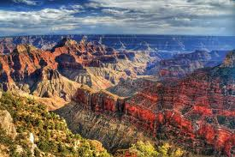
$400 Question from Geology
Which process is most responsible for the formation of the Grand Canyon?

Slide 29
$400 Answer from Geology
Erosion by wind and water

Slide 30
$500 Question from Geology
A _______ revolves around a planet.

Slide 31
$500 Answer from Geology
moon

Slide 32
$100 Question from Meteorology
What is the term given to the
area where a warm air mass and a
cold air mass collide?

Slide 33
$100 Answer from Meteorology
front

Slide 34
$200 Question from Meteorology
What is the name of the largest
and strongest storm on Earth?

Slide 35
$200 Answer from Meteorology
A hurricane

Slide 36
$300 Question from Meteorology
Fill in the blank
*A _________________ cloud
type can be found during a
thunderstorm.

Slide 37
$300 Answer from Meteorology
cumulonimbus

Slide 38
$400 Question from Meteorology
What are the FOUR types of
precipitation?

Slide 39
$400 Answer from Meteorology
Rain, Snow, Sleet and Hail

Slide 40
$500 Question from Meteorology
At what temperature, in
fahrenheit, does water
freeze?

Slide 41
$500 Answer from Meteorology
32 degrees F

Slide 42
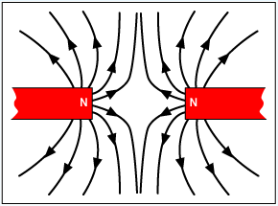
$100 Question from Electricity
Describe what is happening in the
picture below: REPEL or ATTRACT

Slide 43
$100 Answer from Electricity
repel

Slide 44
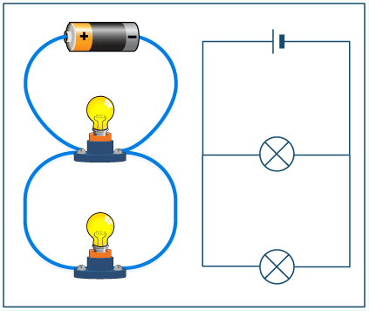
$200 Question from Electricity
What type of circuit is being illustrated
in the diagram below?

Slide 45
$200 Answer from Electricity
Parallel circuit

Slide 46
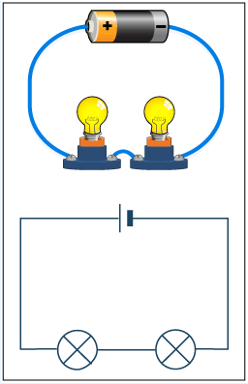
$300 Question from Electricity
What type of circuit is being illustrated
in the diagram below?

Slide 47
$300 Answer from Electricity
Series circuit

Slide 48
$400 Question from Electricity
Name at least ONE metal that
can be attracted by a magnet?

Slide 49
$400 Answer from Electricity
Iron, steel cobalt or nickel

Slide 50
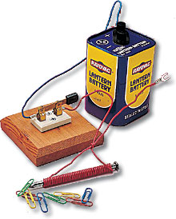
$500 Question from Electricity
Which of the following is shown
below?
Electromagnet
Electric motor
Electric generator
transformer

Slide 51
$500 Answer from Electricity
A. Electromagnet

Slide 52

Final Jeopardy
What is the TOTAL number of atoms found in
H2O?

Slide 53
Final Jeopardy Answer
Total of 3;
2 Hydrogen and 1 Oxygen

